Slide 1
Notes:
Welcome to the IFST Food Industry Outreach Toolkit. In the following slides, see the notes section for information about using the slide, and some tips on what you might like to talk about.

Slide 2
Kickstart your career in the Food Industry
Amy Smith
Notes:
What you can edit: the title of the presentation line and name line
Use this as a title slide for your outreach session to put on screen before you start presenting. You may want to add your company's logo.

Slide 3


Amy Smith
Head of Innovation
Greencore
Notes:
What you can edit: change the photo, name and job role, and place your company logo in the bottom right semi-circle.​
​
You might like to let the class know where you’ve travelled from, what your favourite thing about your job is, or perhaps a fun non-work fact about yourself.

Slide 4



Student
R&D Technologist
BSc Food Science with Industrial placement year
Lead technologist within cross category team
Product Technician
Head of Innovation
Worked on NPD of walkers baked snacks
Leading NPD within global business
Notes:
What you can edit: change the logos in each of the circles to match the companies or institutions you’ve worked or studied at. You can add the name of the job, and a short description of that role.​
​
Here, you might like to speak about the dates you were in each role, or talk about what you learnt in each of the roles. You might like to add where you were located, particularly if travel has featured in your career. If you’ve spent time outside of the food industry, include that too – it’s always helpful for students to see different career paths!

Slide 5
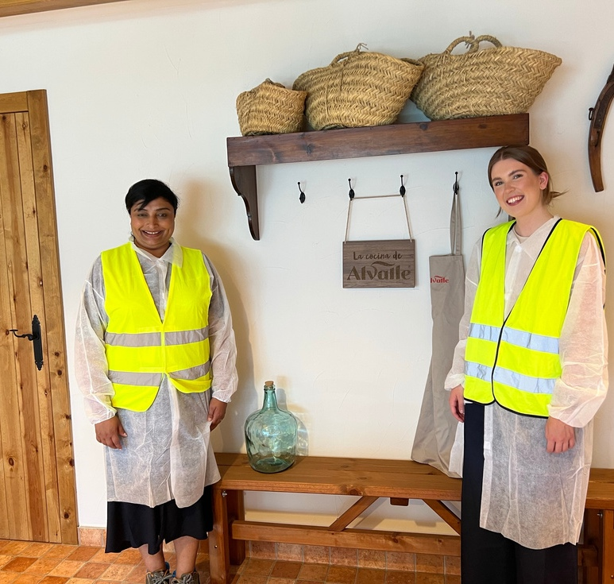
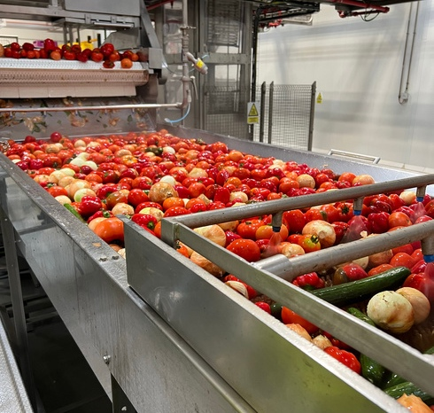
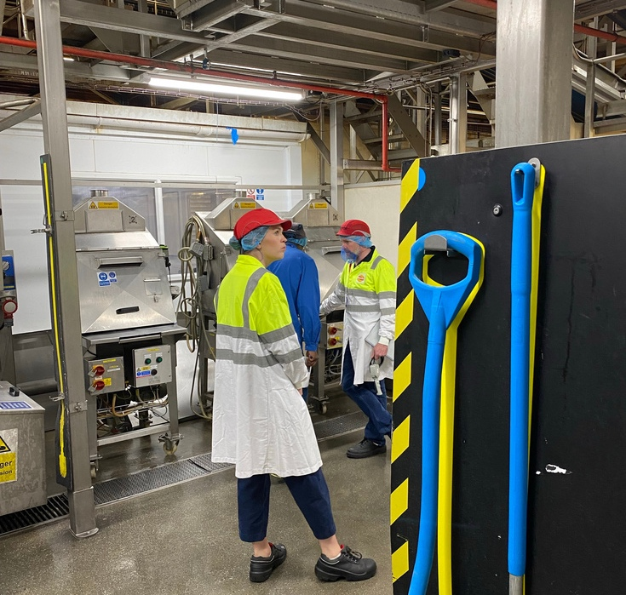
Process Development
Factory Trials
Analytical testing
Notes:
What you can edit: change the photos to show activities you regularly do as part of your current role. Place a short description under the photos.​
​
It may be useful to expand on what each activity includes, particularly if it’s something the class may not have heard of or encountered before (such as benchmarking, analytical testing or scoping). Feel free to mention other activities which aren’t pictured, and don’t feel you have to only include ‘exciting’ parts of the job!

Slide 6
Notes:
This slide is not editable.​
​
You could start by asking the students how many people they think work in the food industry, which food companies they’ve heard of, or how much money the food industry makes each year. You could ask them what they think of the food industry, or what trends they see at the moment - something to engage students after the previous video.​
You may want to compare the size of the food industry to other statistics – for example, ½ a million people is the population of Edinburgh! £38 billion pounds is the equivalent of 12.3 billion bottles of Heinz tomato ketchup! Or, focus on the sustainability and health aspects the food industry are positively contributing to, like reducing plastic packaging, and salt, fat and sugar in foods. This is about helping students to understand the size of the industry, but also get them excited about it.

Slide 7
Notes:
This slide is not editable.​
​
This follows on from the previous slide, about getting students excited about the food and drink industry. Perhaps at the beginning of the slide, you could ask what aspects of work the students would be most excited about, or would look for in a future role. This may work best with older students. Use their answers, if possible, to link back to the food industry, which provides so many great opportunities for diverse, satisfying careers.

Slide 8
Notes:
This slide is not editable.​
Continuation from previous slide

Slide 9


Notes:
What you can edit: change the image in the middle of the slide to reflect the product your business produces, or perhaps your favourite food if that’s not applicable. If possible, it’s often fun to bring in some of that product for students to look at, handle, and understand why so many people are involved in making it.​
​
This slide is all about showing students how many people and disciplines are involved in making food – the key is that there is a role for all sorts of disciplines in the food industry, from food scientists to accountants, and technicians to marketing professionals. Before you start, perhaps you could ask students what they think is involved in making your chosen product. Then, use their ideas to explain and identify the other roles that are involved. Some may need more explaining than others, and make sure to let the students know this is not an exhaustive list, but that it gives a sense of how many teams are involved in making one product. ​

Slide 11
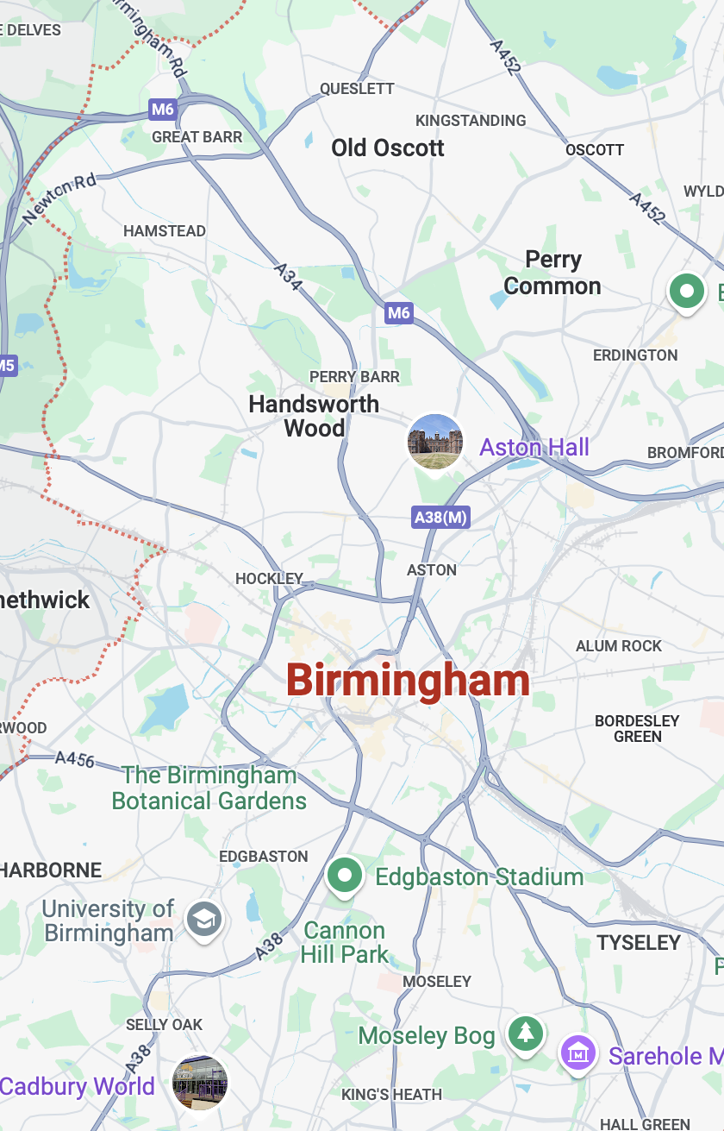

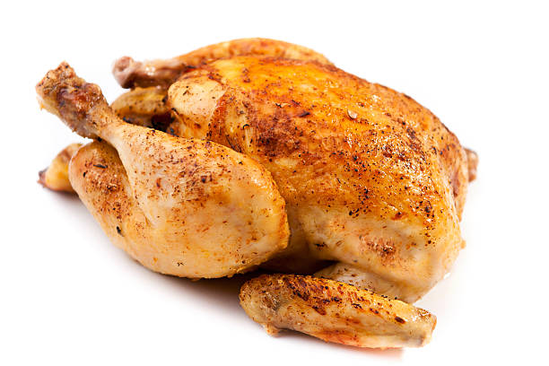





Process fresh and frozen poultry products for supermarkets
Produce soft drinks such as tonic water and lemonade
Produce chocolate and biscuits for brands such as Cadbury
Notes:
What you can edit: change the map on the phone to show your area, and choose three food businesses to showcase in the white boxes on the right. Write a short description of the business, and add a logo and example product image.​
​
This is about showing students how close to home the food industry is. Perhaps you could ask if students have seen products produced by that manufacturer in their local shop, or whether they’ve travelled past the site before. ​
​
It might be nice to end the session with around 10 minutes of Q&A time, or move on to an activity or video.

